Slide 1

Consumers Cooperative’s engagement on FWL
Fabrizio Fabbri - Euro Coop - Bruxelles January 2025

Slide 2
The Rochdale Principles of Co-operation
Voluntary and open membership
Democratic control - one member, one vote
Payment of limited interest on capital
Surplus allocated in proportion to members' purchases - the dividend
Educational facilities for members and workers

Slide 3
The Rochdale idea of Co-operation has spread throughout the world and today there are 1 billion Co-operators in 95 countries
Euro Coop was one of the first NGOs to be recognised by the European Commission back in 1957. Today, we represent 19 national co-ops, some 7,000 co-op enterprises, 94,000 points of sale, some 750,000 employees
We are owned and governed by 30 million consumers-members with an annual turnover of about 65 billion
Together, Euro Coop members are Europe’s second strongest retail force, united by the shared social values and societal commitments that inspired the founders.

Slide 4
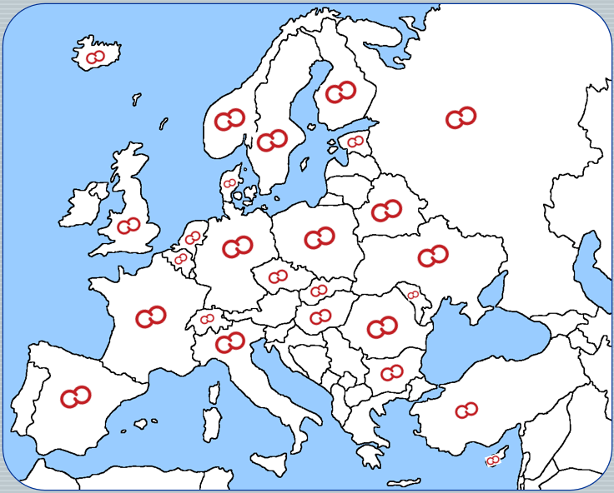
Pan-European market presence
Largest business network
2nd strongest retail force

Slide 5
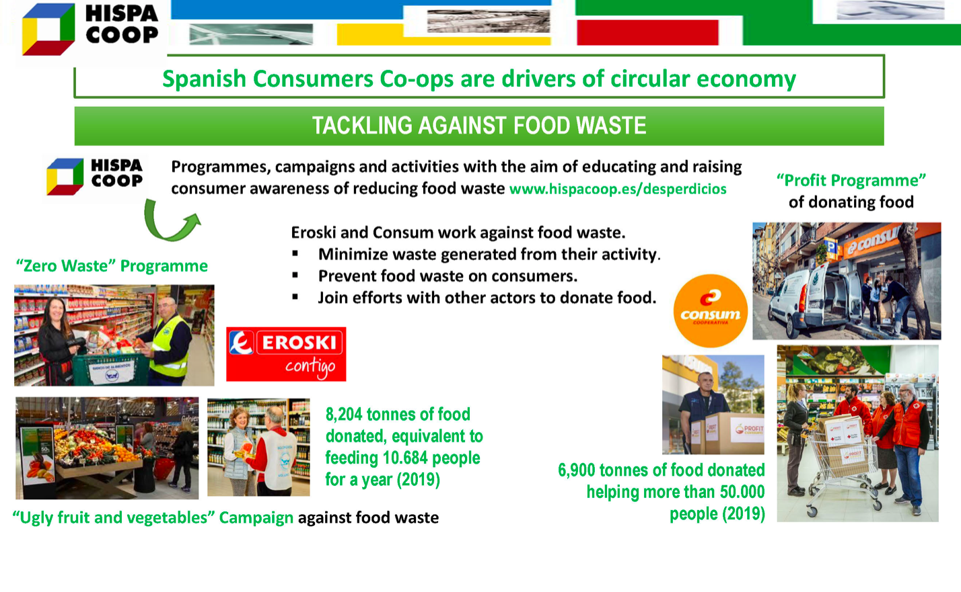
ES

Slide 6
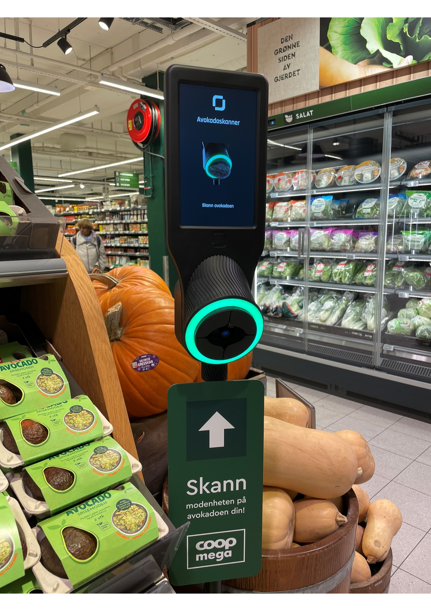

Slide 7
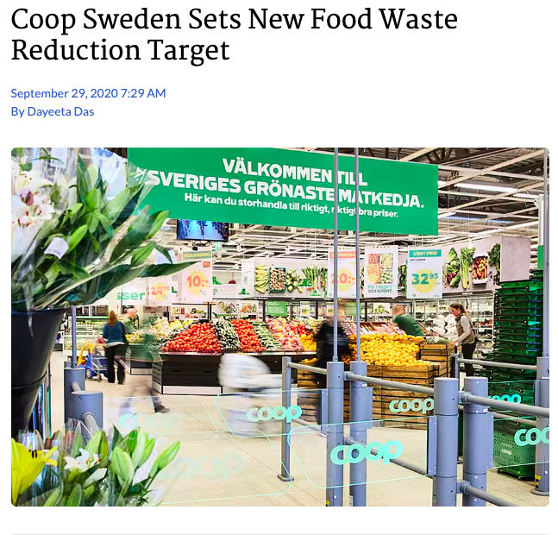

Slide 8
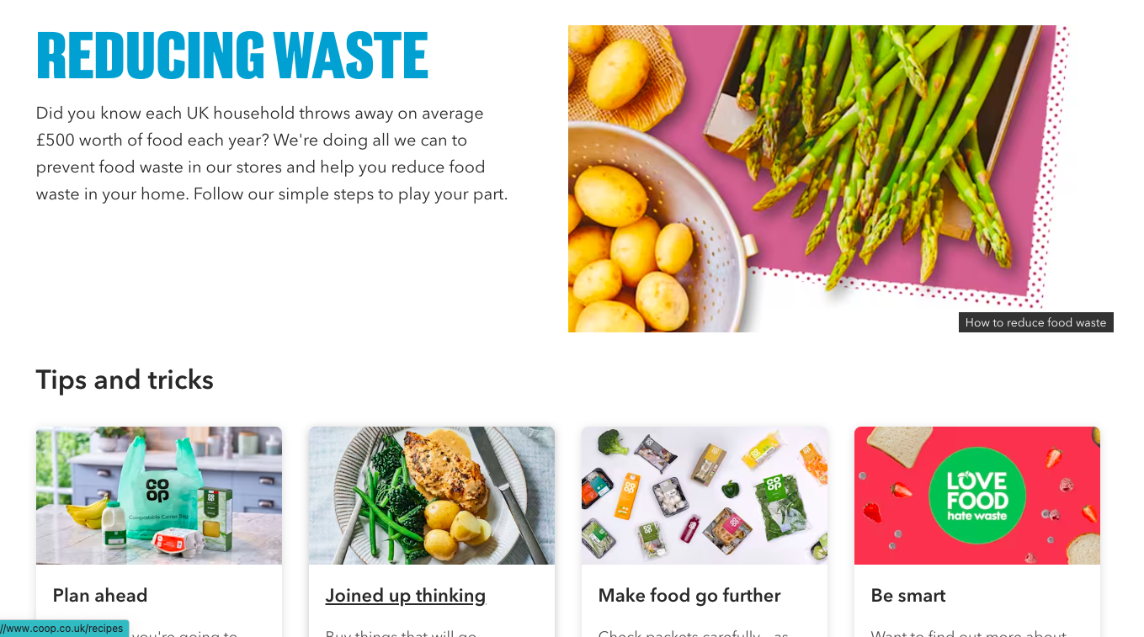

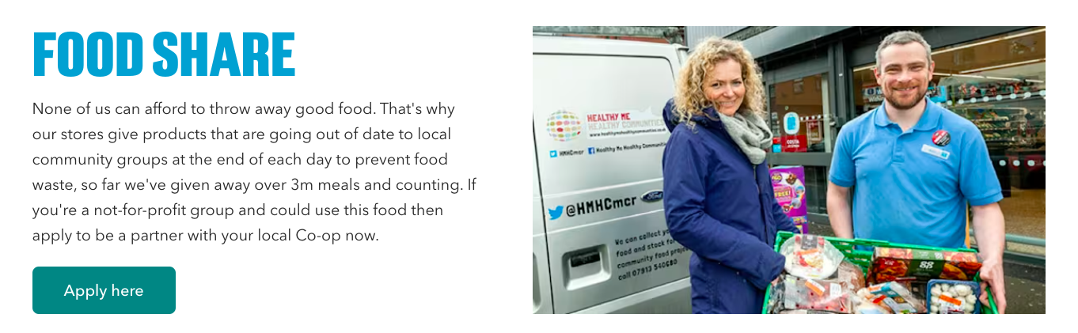

Slide 9
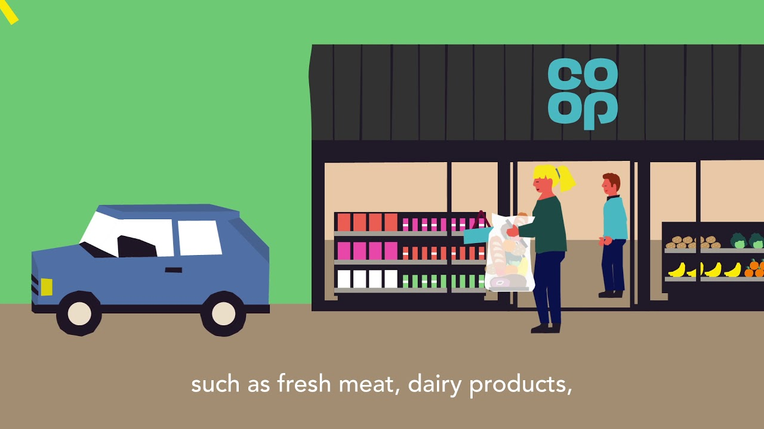

Slide 10


Slide 11
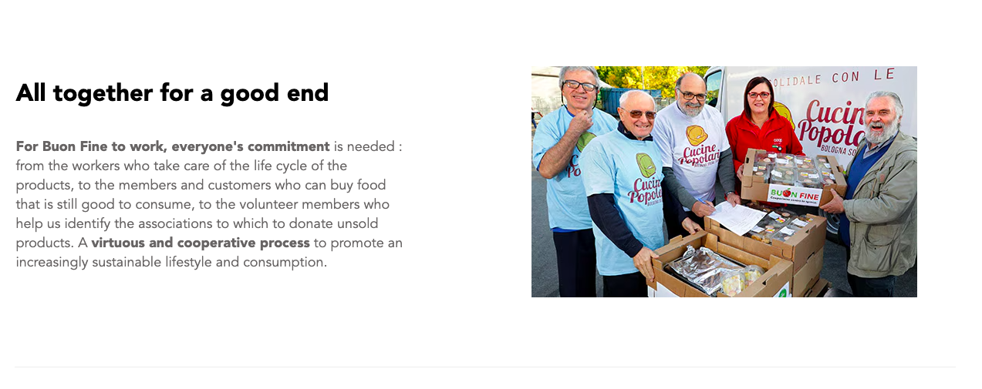
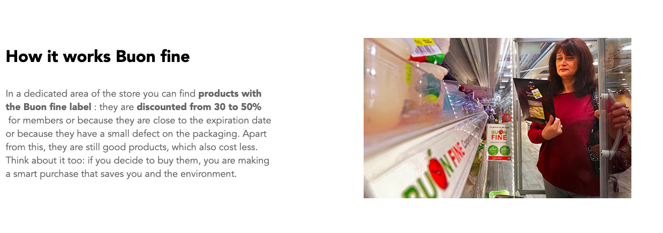
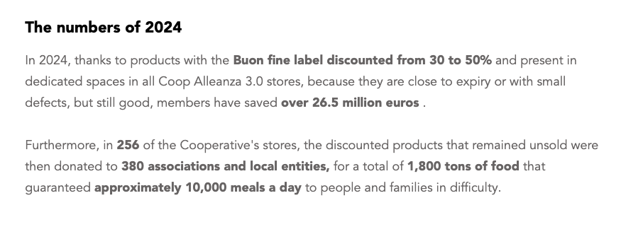
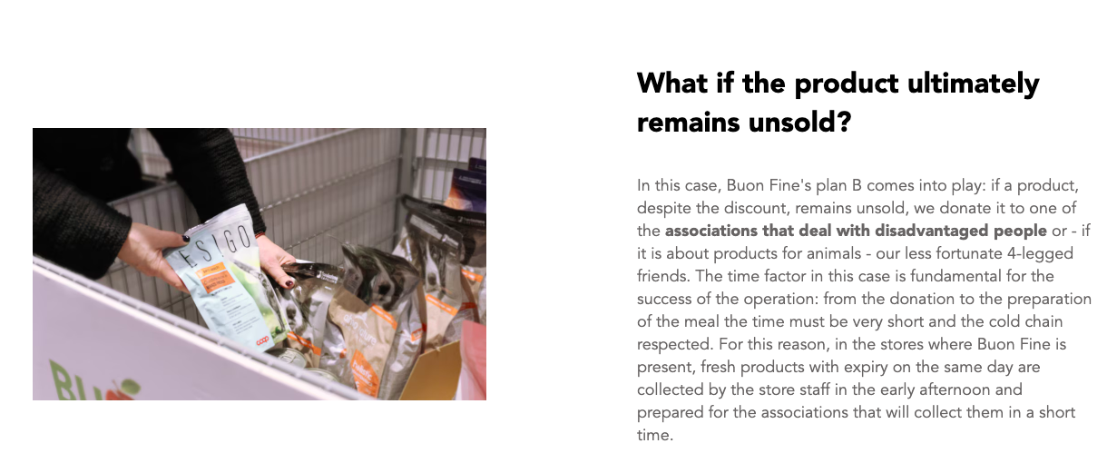

Slide 12
Conclusion
Social values embedded in cooperative systems DNA
Always applying stricter then legally binding criteria and rules
Fully engaged to respond to existing and new societal challenges
Willing to play a forefront’s role in leading the way to sustainability in retailing system

Slide 13
THANKS FOR YOUR ATTENTION !

